Slide 1

Blockchain-Enabled Health Monitoring System
Project Guide
Prof. Vaibhav Yavalkar & Prof. Aishwarya Londhe
NAME | MOODLE ID
Krishna Gupta | 21107024
Meris Gada | 21107041
Tushar Goud | 21107027
Om Jondhale | 21107053
Prathamesh Babar | 21107058

Slide 2
Contents
Abstract
Introduction
Objectives
Literature Review
Research Gap
Problem Definition
Scope
Technological Stack
Proposed System Architecture/Working
Prototype Design Demonstration
Implementation Status
Review Suggestions (Given in Last meeting)

Slide 3
Abstract
This project explores the development of a secure and scalable smart health monitoring system that combines Internet of Things (IoT) devices with blockchain technology to enhance patient care and data management. The system uses a wristband equipped with sensors to monitor real-time health metrics like heart rate, oxygen saturation, and body temperature. IoT devices collect and transmit data, which is securely stored on a blockchain, ensuring data integrity and preventing unauthorized access. By addressing key challenges such as data privacy, security, and interoperability, the system aims to improve healthcare outcomes, enhance patient engagement, and ensure efficient, secure data handling.

Slide 4
Introduction
The project aims to develop a secure and scalable smart health monitoring system by integrating IoT and blockchain technologies to enhance patient care and streamline data management.
The system includes a wristband equipped with sensors to monitor real-time health metrics such as heart rate, oxygen saturation, and body temperature, continuously collecting data via IoT devices like wearable sensors and medical equipment.
The collected health data is securely transmitted and stored on a blockchain network, ensuring data integrity and protection against unauthorized access.
The decentralized framework of blockchain addresses traditional healthcare challenges in data privacy, security, and interoperability. The system enhances data security, transparency, and patient engagement through cryptographic methods and seamless interoperability across platforms.

Slide 5
Objectives
Real-Time Health Monitoring: Implement a wristband equipped with IoT sensors to continuously monitor real-time health metrics such as heart rate, oxygen saturation, and body temperature, and securely transmit this data.
Data Privacy and Security: Leverage blockchain technology to ensure the secure transmission and storage of health data, maintaining data integrity and preventing unauthorized access through cryptographic methods.
Interoperability and Transparency: Design a system that enables seamless data sharing across platforms, improving transparency and integration between healthcare providers, patients, and stakeholders.
Granular Access Control: Use blockchain-based smart contracts to implement precise access controls, allowing only authorized personnel to view or manage sensitive patient data.

Slide 6
Literature Review
Sr.no | Title | Author(s) | Year | Methodology | Drawback
1 | Heart Rate Monitoring System[1] | Deependra Sinha, Tapas Gupta, Shraddha Verma, Sweety Verma, Vijaylaxmi | 2021 | The research focuses on a telemedicine-based patient health monitoring system using IoT technologies. It uses pulse sensors, Arduino UNO microcontrollers, and the BLYNK App for real-time data transfer and visualization. The system uses a wired connection for remote monitoring and aims for simplicity. | The research highlights limitations of a device, including heavy hardware, slow data transfer, and limited mobility due to its tethered nature, which limits the patient's ability to move freely in dynamic environments

Slide 7
Literature Review
Sr.no | Title | Author(s) | Year | Methodology | Drawback
2 | An Intelligent and Secure Health Monitoring System Based on Agent[2] | Maroua Ahmid, Okba Kazar, Saber Benharzallah, Laid Kahloul, Abdelhak Merizig | 2020 | The paper presents a secure IoT-based health monitoring system that uses multi-agent systems and advanced cryptography for real-time monitoring. It features an agent-based architecture, collecting heart rate data from Raspberry Pi 3 B+ with a pulse sensor, and uploading it to the cloud for secure storage and real-time access. The system also sends real-time notifications for abnormal heart rate levels. | The advanced system has limitations, including reliance on constant internet connectivity, hardware limitations due to Raspberry Pi and pulse sensors, and agent complexity, which may limit monitoring scope and management over time, especially in rural or remote areas.

Slide 8
Literature Review
Sr.no | Title | Author(s) | Year | Methodology | Drawback
3 | IoT-based Secure Healthcare Monitoring System[3] | Dr. Anil Ramachandran Nair, Dr. R. K. Sharma, Naveen | 2019 | The research presents an IoT-based healthcare monitoring system that uses sensors and a cloud-based platform to monitor patient physiological parameters. The system uses sensors like heart rate, body temperature, ECG, and blood pressure, and a Raspberry Pi for processing data. The system uses pre-processing techniques to handle noisy data, secures data transmission using AES 128-bit encryption, triggers real-time alerts, and integrates data into a secure cloud platform. | The system faces challenges in managing large volumes of real-time healthcare data, limited accessibility due to poor internet coverage, scalability issues for large hospitals, and power dependency due to its dependence on a continuous power supply, which can be problematic in unstable electricity areas.

Slide 9
Literature Review
Sr.no | Title | Author(s) | Year | Methodology | Drawback
4 | Wearable Health Monitoring System for Older Adults in a Smart Home Environment | Rajdeep Kumar Nath, Himanshu Thapliyal | 2021 | The methodology involves using wearable sensors (EDA, PPG, and ST) in a wristband to monitor stress, with salivary cortisol as the stress biomarker. Machine learning models were trained using features from these physiological signals for stress detection. Additionally, a PPG-based model estimates blood pressure, and an indoor location detection system tracks the user’s movement, all integrated into a smart home environment with voice interaction. | Some drawbacks of the system include the reliance on wearable sensors, which may be uncomfortable or prone to user non-compliance over long periods. The blood pressure model, based solely on PPG signals, may lack the accuracy of multi-sensor approaches like ECG. Additionally, real-time data streaming and processing could introduce delays, and the system's efficacy may be limited by environmental factors affecting sensor accuracy.

Slide 10
Literature Review
Sr.no | Title | Author(s) | Year | Methodology | Drawback
5 | Secure Remote Health Monitoring System and assessment using IOT | Rajesh TM, Tina Babu, Rekha R Nair, Nivedha S | 2022 | The system uses embedded sensors (e.g., temperature and heart rate) connected to an Arduino Nano microcontroller to collect health data, which is transmitted via Bluetooth to a cloud server for real-time analysis. Homomorphic encryption ensures secure data transfer, and the system categorizes health status as critical, normal, or dangerous. The data is accessible through an Android app for continuous monitoring by authorized users. | The system faces challenges like limited Bluetooth range, which may cause connectivity issues in larger areas. The use of homomorphic encryption can slow down real-time data processing, and the reliance on external sensors adds hardware complexity and maintenance costs. Additionally, sensor accuracy could be impacted by environmental factors, affecting the reliability of health assessments​.

Slide 11
Literature Review
Sr.no | Title | Author(s) | Year | Methodology | Drawback
6 | Optimised Algorithm for Step Count Estimation Using Sensor Data from Smartphones and Wearables | Apratim Shrivastav, Utkarsh Kuchhal, Samarth Singhal, Tanmay Jain, Divyashikha Sethia, Vidushi Chaudhary | 2022 | The methodology proposes an optimized algorithm for step count estimation using accelerometer data by normalizing acceleration across the x, y, and z axes. A low-pass Butterworth filter reduces noise, and peak detection identifies steps while avoiding false peaks. The algorithm is highly accurate, outperforming machine learning and deep learning models like SVM and CNN in step count estimation. | The algorithm's peak detection may struggle with irregular walking patterns and abrupt movements, leading to missed steps or over-counting in noisy environments. While the low-pass Butterworth filter is effective, it might smooth out important signal variations. Additionally, the algorithm's performance could decline in diverse real-world conditions not represented in the dataset.

Slide 12
Literature Review
Sr.no | Title | Author(s) | Year | Methodology | Drawback
7 | IOT based Wearable Smart Health Band Assistance | Kaveri Ramesh Dabhade, Kiran Suresh Mulik | 2020 | The methodology involves using sensors (pulse, temperature, and alcohol) connected to an Arduino Nano to monitor vital signs like heart rate, body temperature, and alcohol levels. Data is processed and transmitted via a Bolt IoT Wi-Fi module to the cloud for real-time monitoring through a smartphone app. Alerts are sent via SMS using the Twilio platform, allowing users to track their health continuously. | The system's drawbacks include its reliance on constant internet connectivity, which may limit functionality in areas with poor coverage. The sensors used, particularly for alcohol detection, may not provide highly accurate medical-grade results. Additionally, the wearable device's size and power consumption could be concerns, potentially requiring frequent recharging or impacting comfort during extended use.

Slide 13
Literature Review
Sr.no | Title | Author(s) | Year | Methodology | Drawback
8 | Internet of things-enabled real-time health monitoring system using deep learning | Xingdong Wu, Chao Liu, Lijun Wang, Muhammad Bilal | 2021 | The methodology involves using IoT-enabled wearable devices to collect real-time physiological data from athletes, which is transmitted via a wireless relay network for analysis. Deep learning algorithms, specifically deep neural networks (DNN), process the data to detect health issues. The system optimizes data through noise reduction techniques like PCA and gradient descent for accuracy, and performance is assessed using precision, recall, AUC, and F1-score. | The drawbacks of the system include its sensitivity to the number of neurons in the DNN, which can lead to issues like underfitting or overfitting. The deep learning model's complexity increases computational costs, and challenges like vanishing gradients may arise with deeper networks. Additionally, the system’s reliance on continuous data transmission may face issues with unstable network access or energy efficiency.

Slide 14
Literature Review
Sr.no | Title | Author(s) | Year | Methodology | Drawback
9 | Wrist-Card: PPG Sensor based Wrist Wearable Unit for Low Cost Personalized Cardio Healthcare System | Shaikh Anowarul Fattah, Mohammad Mahinur Rahman, Nafis Mustakin, Mohammad Tariqul Islam, Asir Intisar Khan, Celia Shahnaz | 2017 | The methodology involves using IoT-enabled wearable devices to collect real-time physiological data from athletes, which is transmitted via a wireless network for analysis. Deep neural networks (DNN) process this data to detect health risks. The system applies noise reduction techniques like PCA and optimizes performance using gradient descent algorithms. | The main drawbacks include the deep learning model's sensitivity to neuron numbers, leading to potential underfitting or overfitting. The system's complexity also increases computational costs, and issues like vanishing gradients may arise with deeper networks. Additionally, continuous data transmission may face challenges due to unstable network access or energy efficiency concerns​.

Slide 15
Literature Review
Sr.no | Title | Author(s) | Year | Methodology | Drawback
10 | Monitoring Heart Rate And Temperature Based On Internet Of Things | Rangga Adi F, Bambang Guruh I, Sumber | 2019 | The study uses an IoT-based system to monitor heart rate and body temperature remotely. ECG signals are captured via electrodes, processed through amplifiers and filters to remove noise, while body temperature is measured using the DS18B20 sensor. Data is transmitted via the ESP32 microcontroller to the ThingSpeak platform, enabling real-time monitoring and notifications for abnormal values. | The main drawbacks of the system include the significant error margin during patient movement, which affects the accuracy of heart rate and temperature readings. Additionally, the system's performance is heavily dependent on the stability and quality of the internet connection, which can cause delays in data transmission and monitoring​.
Notes:
.

Slide 16
Research Gap(Limitations of existing
systems)
The system struggles with large data management, limited monitoring, lacks predictive analytics and GPS for emergencies, and requires expansion of biometric readings along with improvements in user interface accessibility and data control.[1].
The system lacks comprehensive features, including advanced monitoring, long-term data analysis, scalability, and security, while depending on a continuous power source.[2].
The paper stresses the need for lightweight, wireless IoT solutions to improve patient mobility, scalability, and connectivity.[3].

Slide 17
Problem Definition
Traditional systems are unable to effectively integrate IoT devices with strong security frameworks, leading to unauthorized access, data breaches, and fragmented data handling. Existing systems struggle with real-time health data monitoring, data privacy, and secure, scalable data management.
As healthcare shifts toward personalized and real-time patient care, there is a growing need for a secure, interoperable solution to monitor vital health metrics continuously, while ensuring data integrity and privacy.
This project aims to develop a secure, scalable smart health monitoring system using IoT devices and blockchain technology to ensure real-time health data monitoring, data security, privacy, and interoperability.

Slide 18
Scope
Real-Time Health Monitoring: The system will use a wristband to track important health data like heart rate, oxygen saturation, and body temperature, providing real-time updates for both patients and doctors
Data Security and Privacy: Using blockchain technology, all health information will be securely stored and shared, ensuring that only authorized people can access the data and that it cannot be tampered with.
Mobile Application Development: Creating a user-friendly mobile application for accessing health data and insights
Data Visualization: Designing intuitive visualizations to present health data effectively.

Slide 19
Technological Stack
Hardware Component:
Microcontroller:
  ESP32 Devkit V1 for wireless communication (Bluetooth/Wi-Fi) and sensor integration.
Sensors:
  Heart Rate Sensor: A photoplethysmography (PPG) sensor like the MAX30100 or MAX30102 can be used to detect heart rate.
  Temperature Sensor: A small, accurate sensor DHT11 for non-contact body temperature measurement.
  Oxygen saturation Sensor : A small sensor HW827 used for sensing the oxygen saturation in body.

Slide 20
Technological Stack
Software Component:
Arduino IDE for coding and testing the microcontroller.
HW827 for Oxygen saturation detection.
Adafruit MAX30100 library for heart rate sensors.
Bildr library for the DHT11 sensor.
ESP32 for Bluetooth functionality and wifi.
Android Studio (for Android apps), Flutter SDK (for cross-platform apps).
Libraries and dependencies for Bluetooth Low Energy (BLE) communication:
  Android studio/Java for app development.
  BluetoothAdapter and BluetoothGatt for Android.

Slide 21
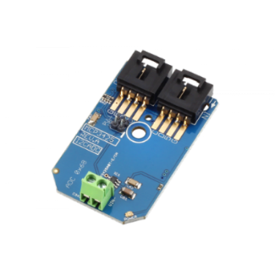
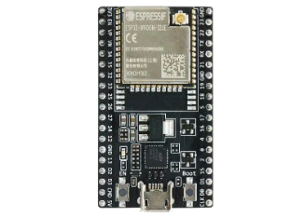

1.Working of IOT sensors
Proposed system architecture/Working
Analog-to-Digital Converter (Converts analog signals into digital data)
Communication
(data transmission)
interface Dashboards (for patients and healthcare providers)
IOT sensors
(Measure specific physical parameters.
Microcontroller
(Processes the digital data)
Data Storage (Centralized storage for all incoming data).

Slide 22
Proposed system architecture/Working
Data collection layer
Patient
Data Processing
Microcontroller
(ESP32)
IOT sensors
MAX30100(Heart rate)
ADC
(Analogue to digital converter)
DS18B20(Temperature)
Data cleansing
MPX5010(Blood pressure)
HW827
(Oxygen saturation)
(As data generates by sensors are in the form of signals)
Digital Data

Slide 23
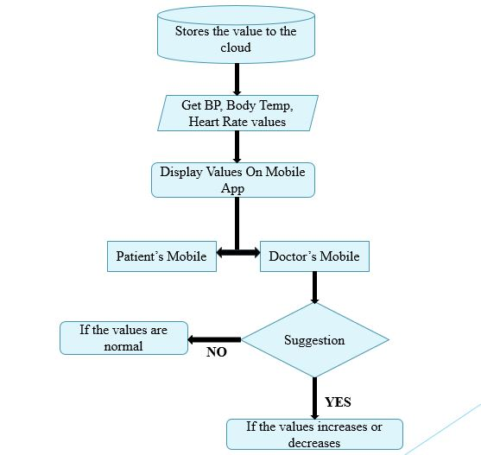
Mobile App Proposed System

Slide 24
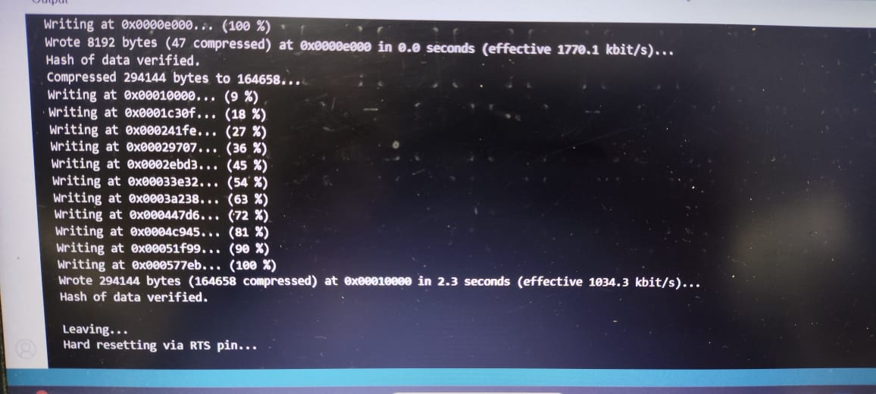
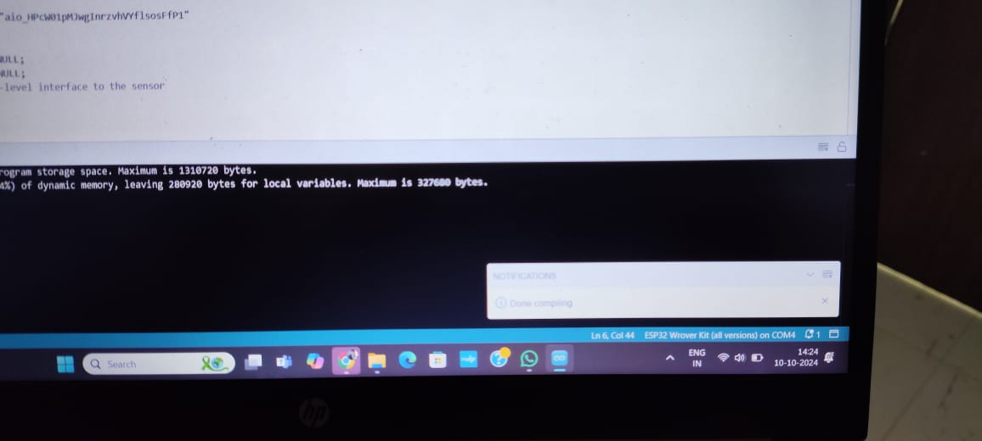
Implementation Status

Slide 25
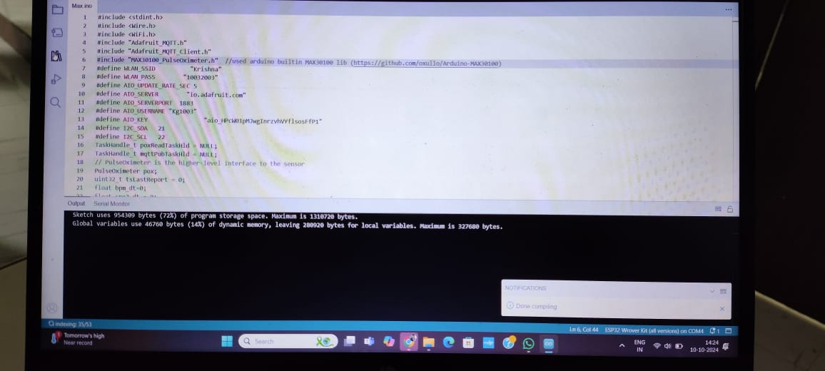
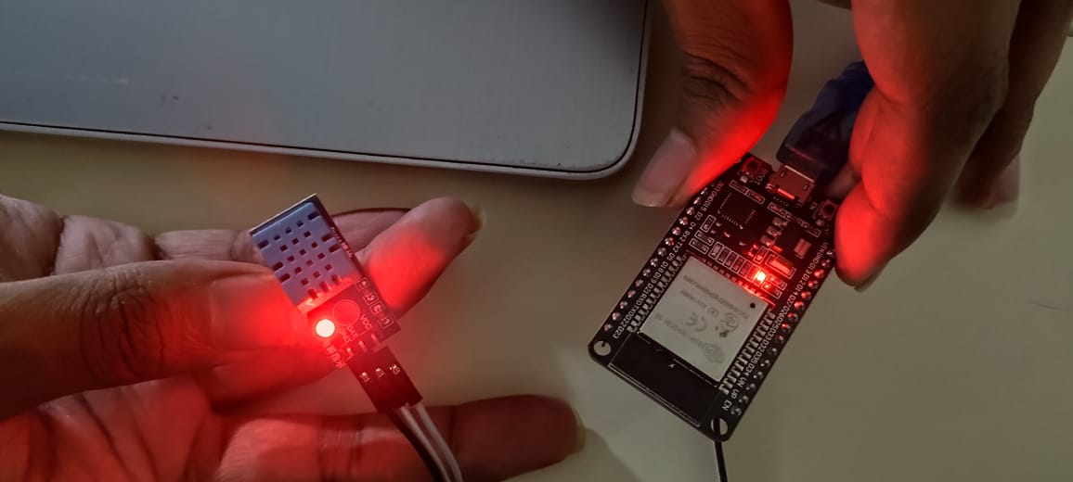
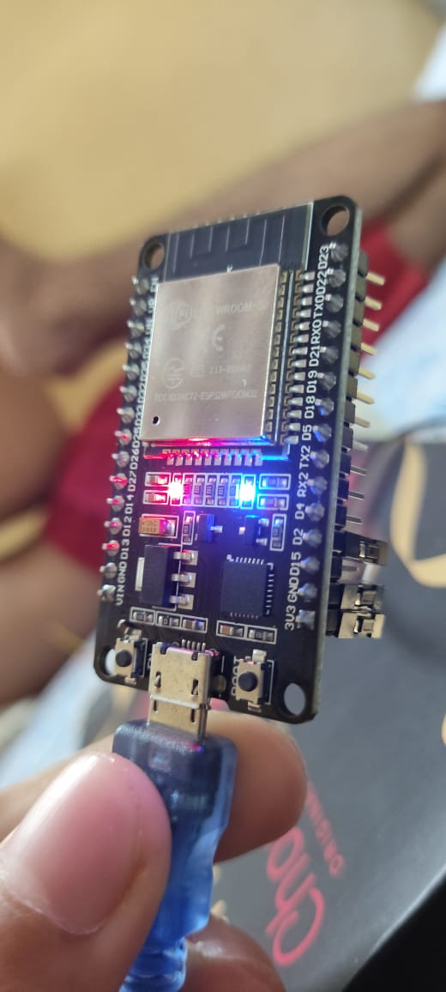
Implementation Status

Slide 26
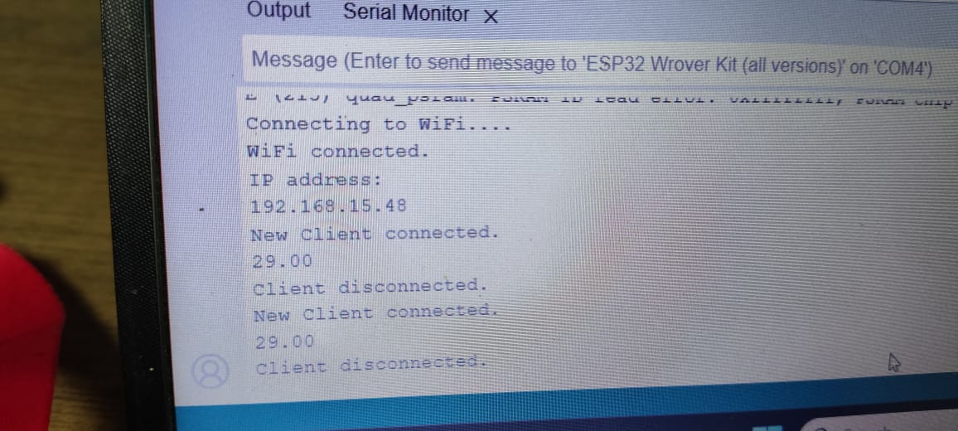
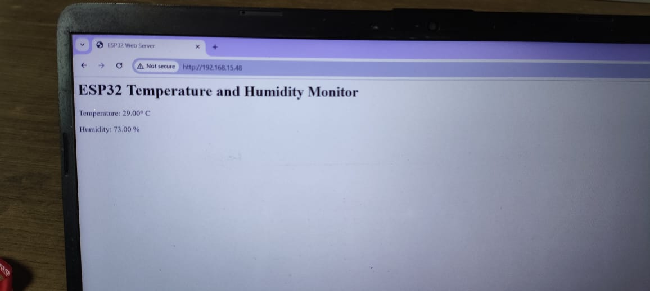
Implementation Status

Slide 27
References
[1] Meenu Bala, Mukesh Prasad, Neeraj Kumar, Karan Singh, Karthikeyan Ramasamy, Valentina Emilia Balas, A Secure IoT-Based Modern Healthcare System Using Deep Learning and Chaotic Cryptography, IEEE Xplore, IEEE Access, Vol. 9, 2021, 93546-93562,2021.
[2] S. Varalakshmi, B. Ranjith Kumar, V. Sri Ramya, K. S. Mahendra, D. Sri Ramya, An Intelligent and Secure Health Monitoring System Based on Agent,IEEE Xplore, IEEE Access,Vol. 8,189-197,2020.
[3] Surjeet Dalal, Maninder Singh, Rajesh Verma, An Intelligent Healthcare Monitoring System Using IoT and Fog Computing, IEEE Xplore, 2019 4th International Conference on Internet of Things: Smart Innovation and Usages (IoT-SIU), Conference Paper,1-6,2019.

Slide 28
References
[4] Rajdeep Kumar Nath, Himanshu Thapliyal, Wearable Health Monitoring System for Older Adults in a Smart Home Environment,IEEE Xplore, IEEE Access, 2021.
[5] Rajesh TM, Tina Babu, Rekha R Nair, Nivedha S, Secure Remote Health Monitoring System and assessment using IOT, IEEE Xplore, International Conference on Artificial Intelligence & Data Engineering (AIDE), 2022.
[6] Apratim Shrivastav, Utkarsh Kuchhal, Samarth Singhal, Tanmay Jain, Divyashikha Sethia, Vidushi Chaudhary, Optimised Algorithm for Step Count Estimation Using Sensor Data from Smartphones and Wearables, IEEE Xplore, 2022.
[7] Kaveri Ramesh Dabhade, Kiran Suresh Mulik, IOT based Wearable Smart Health Band Assistance, International Journal of Engineering Research & Technology (IJERT), Vol. 9 Issue 11,2020.

Slide 29
References
[8] Xingdong Wu, Chao Liu, Lijun Wang, Muhammad Bilal, Internet of things-enabled real-time health monitoring system using deep learning, Springer Xplore, 2021.
[9] Shaikh Anowarul Fattah, Mohammad Mahinur Rahman, Nafis Mustakin, Mohammad Tariqul Islam, Asir Intisar Khan, Celia Shahnaz, Wrist-Card: PPG Sensor based Wrist Wearable Unit for Low Cost Personalized Cardio Healthcare System, IEEE Xplore, 2017.
[10] Rangga Adi F, Bambang Guruh I, Sumber, Monitoring Heart Rate And Temperature Based On Internet Of Things, Journal of Electronics, Electromedical and Medical Informatics (JEEEMI) Vol. 1, No. 2, 2019.

Slide 30
Thank You...!!

